Slide 1




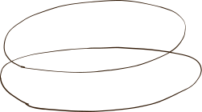


Takhayyul Crafts: Crafting Creativity Together

Slide 2

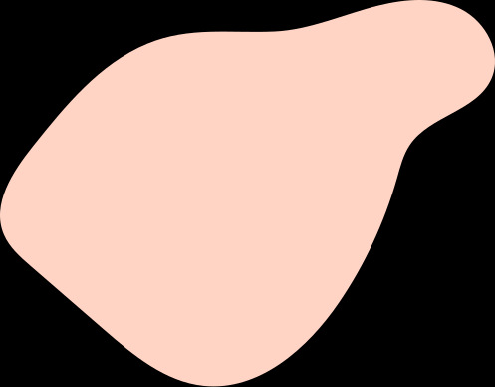



Team Members
1
AYESHA ISRAR
2
MUHAMMAD AHMAD SULTAN
3
SAMAR QAISAR
4
SHANDANA IFTIKHAR

Slide 3
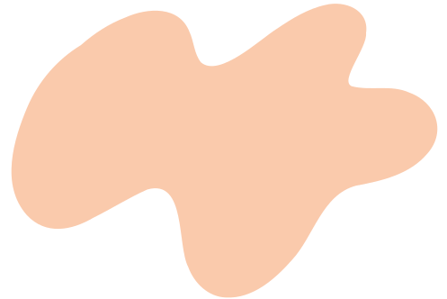




CATALOG
Software Design & Architecture
1
Title of the Project
(SE-211)
2
Abstract and History
3
Objective
COMPLEX ENGINEERING
ACTIVITY
4
Scope
SUBMITTED TO:
LEC. FAWAD KHAN
5
Beyond Current Focus
6

Slide 4
CATALOG
Software Design & Architecture
6
Low Level Design
(SE-211)
6.1
Data Structures
6.2
Algorithms
COMPLEX ENGINEERING
ACTIVITY
6.3
Database
SUBMITTED TO:
LEC. FAWAD KHAN
7
Mid Level Design
Graphical User Interfaces
7.1

Slide 5
CATALOG
Software Design & Architecture
8
High Level Design
(SE-211)
8.1
Architectural Style
8.2
Design Patterns
COMPLEX ENGINEERING
ACTIVITY
9
Future Enhancements
SUBMITTED TO:
LEC. FAWAD KHAN
10
Potential Questions
Conclusion
11

Slide 6
Takhayyul Crafts: Crafting Creativity Together
Takhayyul Crafts is a collaborative online design tool that empowers users to unleash their creativity collectively. Takhayyul Crafts facilitates efficient project management, collaborative design, and secure data handling for creative professionals.

Slide 7


Abstract
The Online Design Tool (ODT) is a sophisticated platform.
Facilitates user interactions, project management, diagram creation, and collaborative work.
Provides a detailed overview of the algorithms underpinning the ODT.
Highlights roles, operations, and significance within the system.
History
Evolution from manual drafting techniques to digital platforms.
Early tools focused on basic drafting capabilities.
Advances in technology led to increased complexity and functionality.
Modern design tools feature:
Real-time collaboration.
Advanced data management.
Integration with other software.

Slide 8
Objective
Provide a user-friendly platform for design projects.
Facilitate efficient creation, management, and collaboration.
Enhance productivity.
Ensure data security.
Support seamless collaboration among users.
Improve the overall design process.

Slide 9



Scope
User Authentication and Authorization
Collaboration Management
Security
Project Management
Data Validation
1
Version Control &
Monitoring
Diagram and Element Management
Backup & Recovery

Slide 10
Beyond Current Focus
Machine Learning Integration
Error Detection
Intelligent Suggestions
Advanced Search
1
Semantic Search
Natural Language Processing
NLP

Slide 11
Design levels
1
Low Level Design
2
Mid Level Design
3
High Level Design

Slide 12
Low Level Design

Slide 13



Low Level Design
Low Level Design (LLD) is the first phase of software design.
Data Structures
Database
LLD, or Low-Level Design, is a phase in the software development process where detailed system components and their interactions are specified.
Algorithms

Slide 14
Different Classes using Data structures:
1
Data Structures
PROJECT CLASS
2
USER CLASS
Each class has different attributes and methods using different data structures for ODT.
3
DIAGRAM CLASS
4
ELEMENT CLASS
Data structures are crucial for managing the data flow and storage in an Online Design Tool (ODT). They define how data is organized, stored, and manipulated within the system
5
COLLABORATION CLASS
ODT DATABASE CLASS
6

Slide 15


Data Structures
Future Enhancements for Data Structures
Enhanced Collaboration Features
1
Core Components:
Advanced Diagramming Tools
2
For designing an online design tool (ODT), the core components include Projects, Users, Diagrams, Elements, and Collaborations
Enhanced Security Measures
3
4
Performance Optimization
By incorporating these enhancements, the ODT application can evolve into a robust and feature-rich platform for software design and collaboration
5
Integration with External Tools

Slide 16
Key Algorithms
1
User Authentication and Authorization
Algorithms
2
Project and Collaboration Management
Ensure efficient management of user interactions, project data, diagram structures, and collaborative functionalities.
3
Diagram and Element Management
4
Monitoring and Version Control
These algorithms are designed to ensure the tool operates efficiently, securely, and effectively, meeting the needs of the users.
5
Data Validation
Security and Backup
6

Slide 17
Algorithms
Future Enhancements for Algorithms
Machine Learning Integration
1
Optimization and Performance
Considerations
Real-time Collaboration
2
3
Advanced Search
Caching
Indexing
Batch Processing
Concurrency Control
4
Automated Backups
5
Integration with External Tools

Slide 18
Database Design
Let's begin

Slide 19
Database
Functional Requirements
User Management
1
Project Management
2
Storage: Holds user information, projects, diagrams, diagram elements, comments, and permissions.
Integrity: Ensures data integrity, consistency, and security.
Efficiency: Provides efficient access and modification capabilities
3
Diagram Management
4
Element Management
5
Commenting
6
Permissions

Slide 20
Database
Non-Functional Requirements
Scalability
1
Performance
2
User Roles and Permissions
Admin: Full access to all functionalities
User: Access to own projects and collaborative projects
Viewer: Read-only access to specific projects
3
Security
4
Reliability

Slide 21
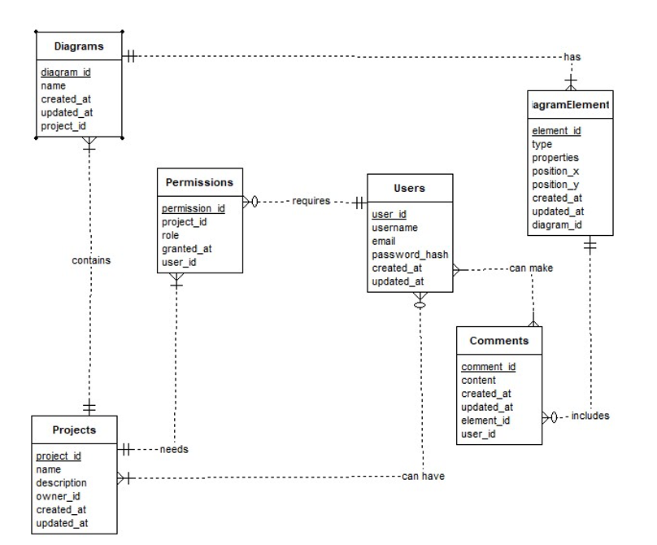

Entity-Relationship Diagram (ERD)

Slide 22



Reasoning behind the Database Design choices
3
Security
Hashed passwords for user protection
Unique email constraints for authentication
4
DateTime Tracking
1
Normalization
Created_at and updated_at fields for record history
Reduces data redundancy
Ensures data integrity
Collaboration
5
2
Flexibility
Text properties
in DiagramElements table for varied attributes
Comments
and Permissions tables for
user interaction and access management

Slide 23
Mid Level Design

Slide 24
Mid Level Design
Mid Level Design (MLD) is the second phase of software design.
Interface for users
GUI
Mid-level design in software development refers to the phase that bridges the gap between high-level design (HLD) and actual coding
Specifies properties, responsibilities, and relationships.

Slide 25

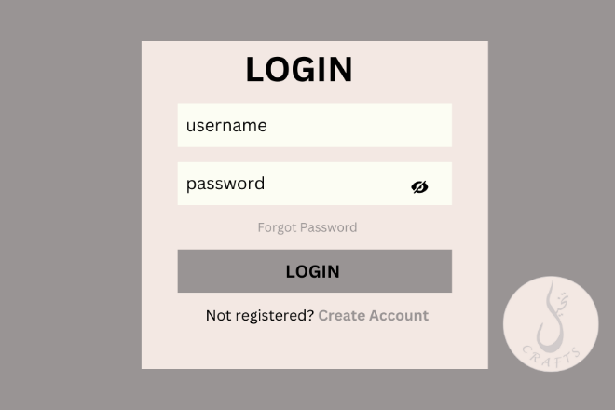
SPLASH
LOGIN

Slide 26
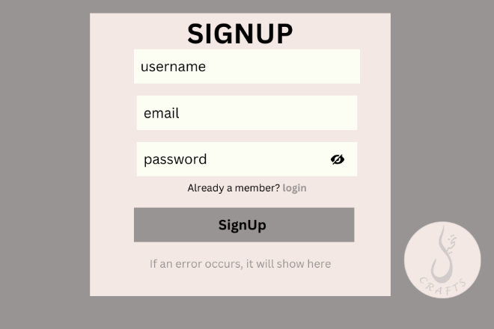
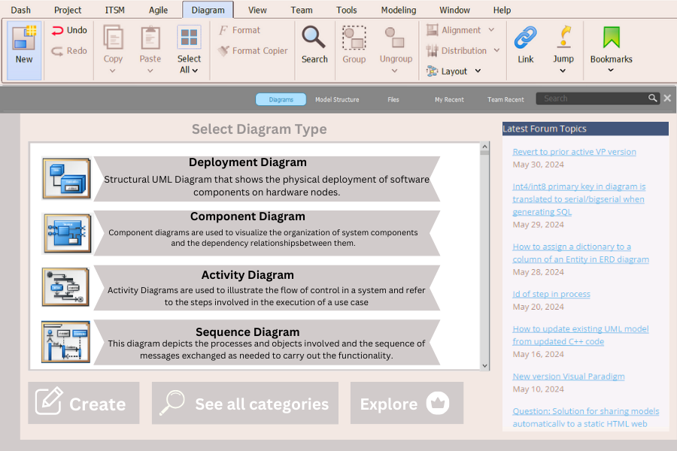
SIGNUP
DASHBOARD

Slide 27
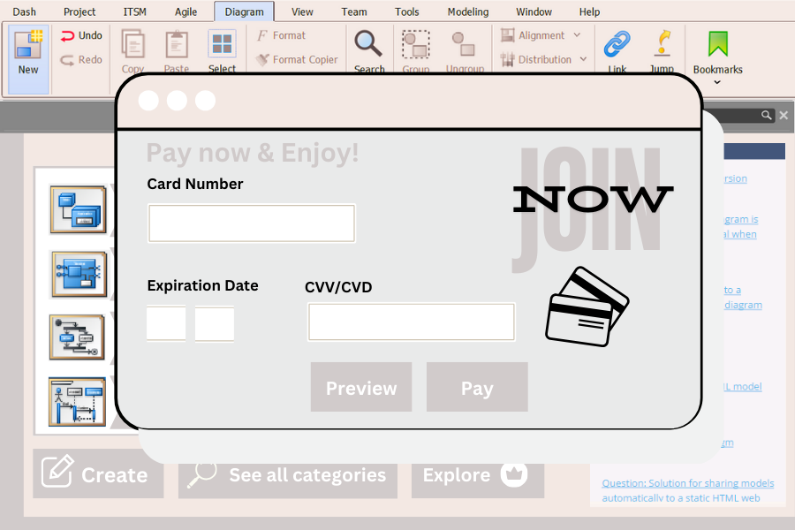
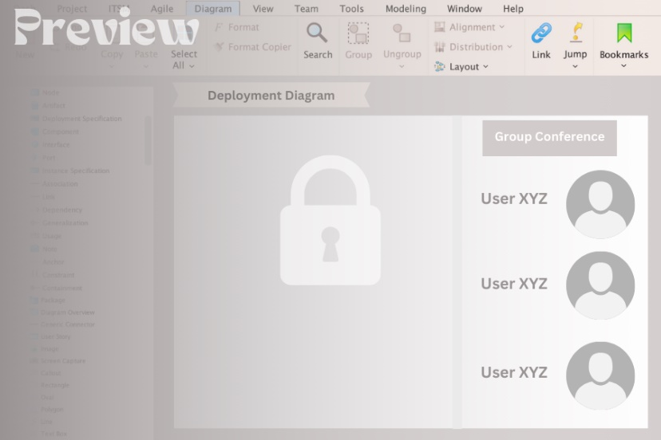
BILLING
PREVIEW

Slide 28
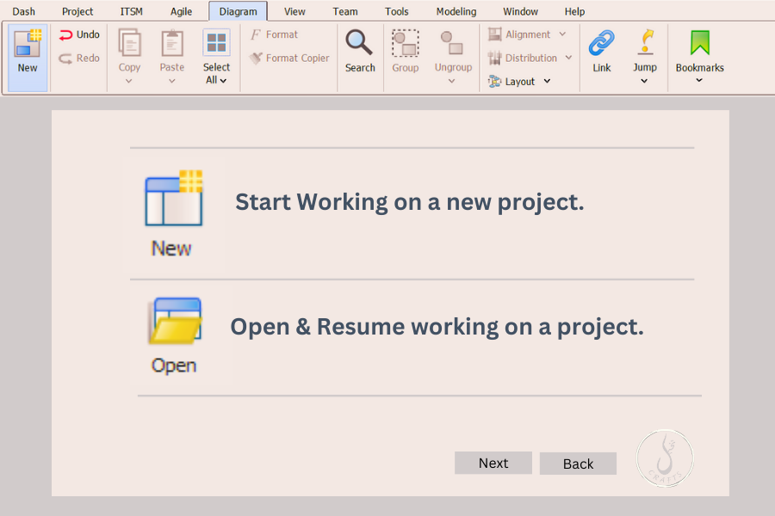
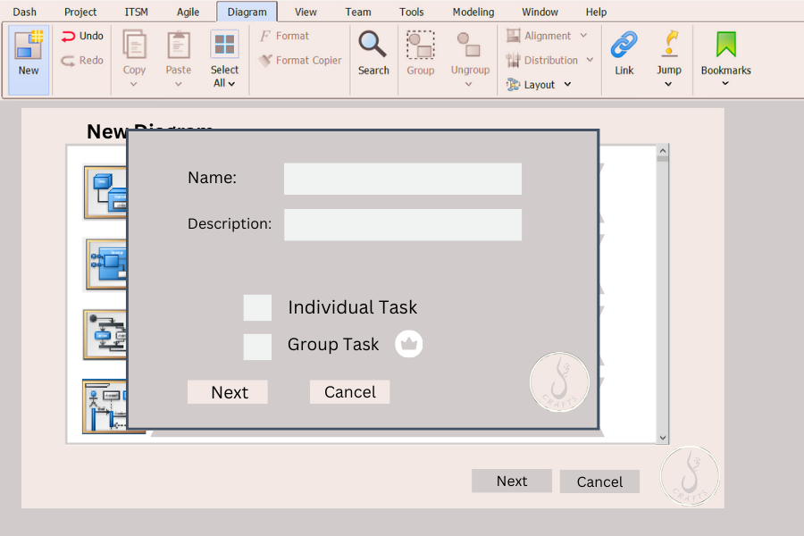
NEW/OPEN PROJECT
PROJECT INFO

Slide 29
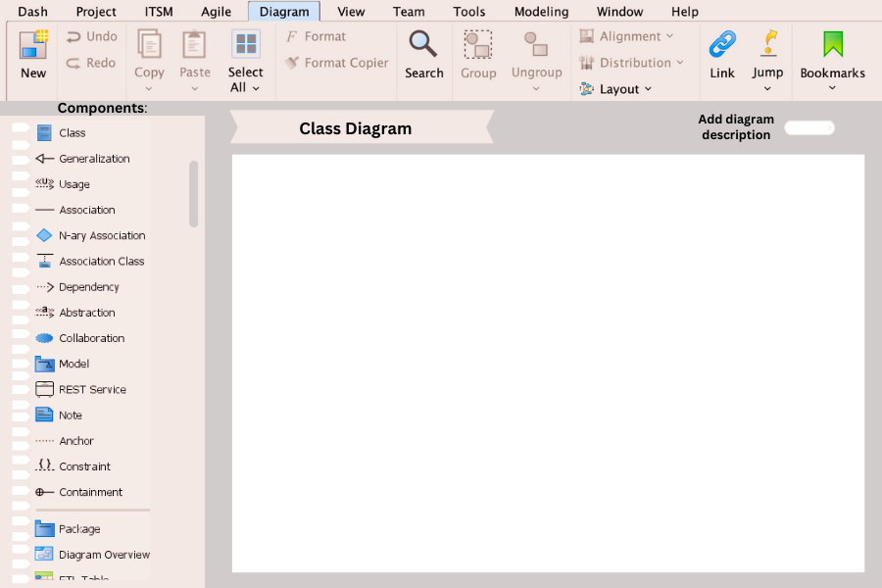
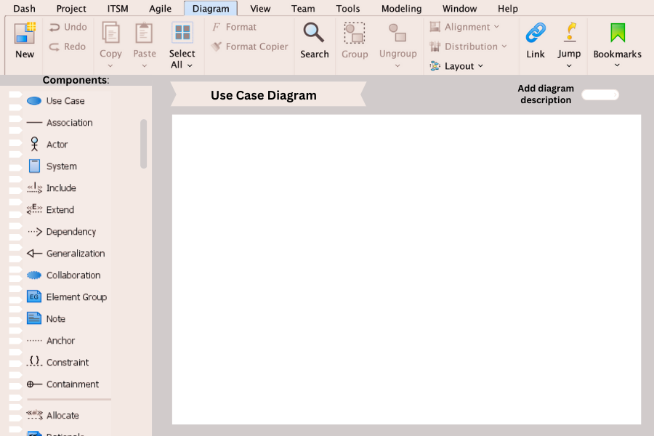
CLASS DIAGRAM
USE CASE DIAGRAM

Slide 30
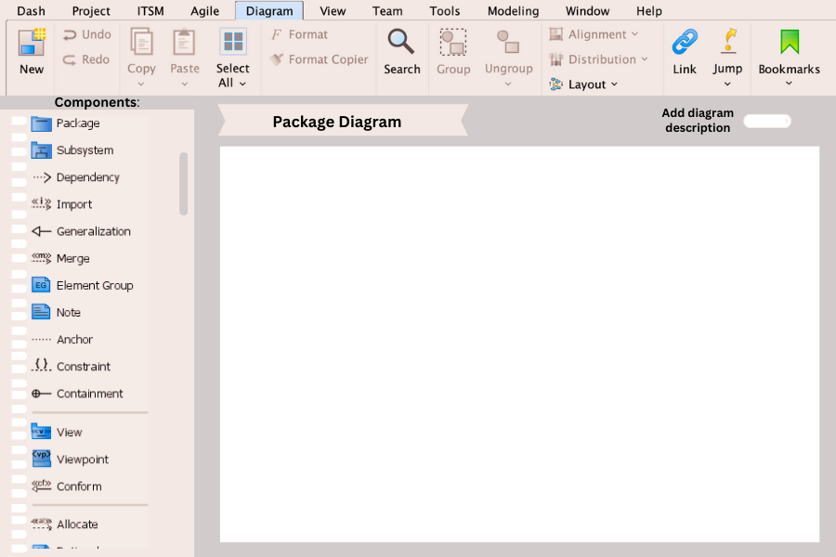
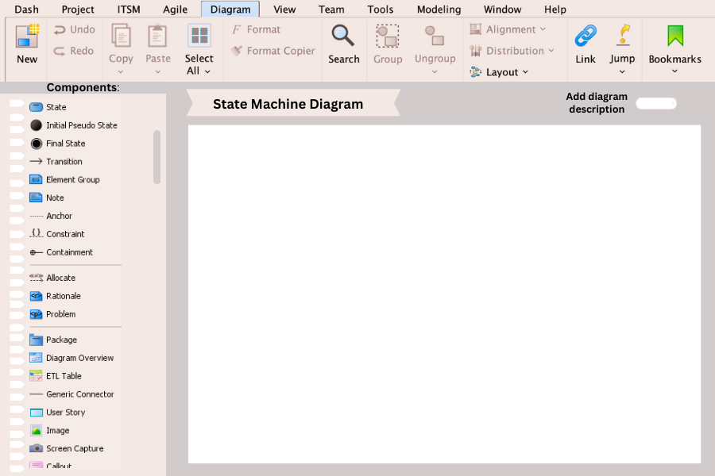
PACKAGE DIAGRAM
STATE MACHINE DIAGRAM

Slide 31
High Level Design

Slide 32
High Level Design
High Level Design (HLD) is the third phase of software design.
Architecture Style
Design Patterns
High-level design or HLD refers to the overall system, a design that consists description of the system architecture and design and is a generic system design
Brief description of systems, services, platforms, and relationships among modules

Slide 33
Architecture Style
What’s more suitable for an ODT?

Slide 34
MVC
Separationn of Concerns:
Model
Rationale:
1
The Model-View-Controller (MVC) architectural pattern is a widely used design pattern for interactive applications. It separates the application into three interconnected components: the Model, the View, and the Controller. This separation facilitates the development, testing, and maintenance of applications by dividing responsibilities and encouraging a clean separation of concerns. Here's why MVC is well-suited for the Online Design Tool (ODT):
2
View:
Controller
3

Slide 35
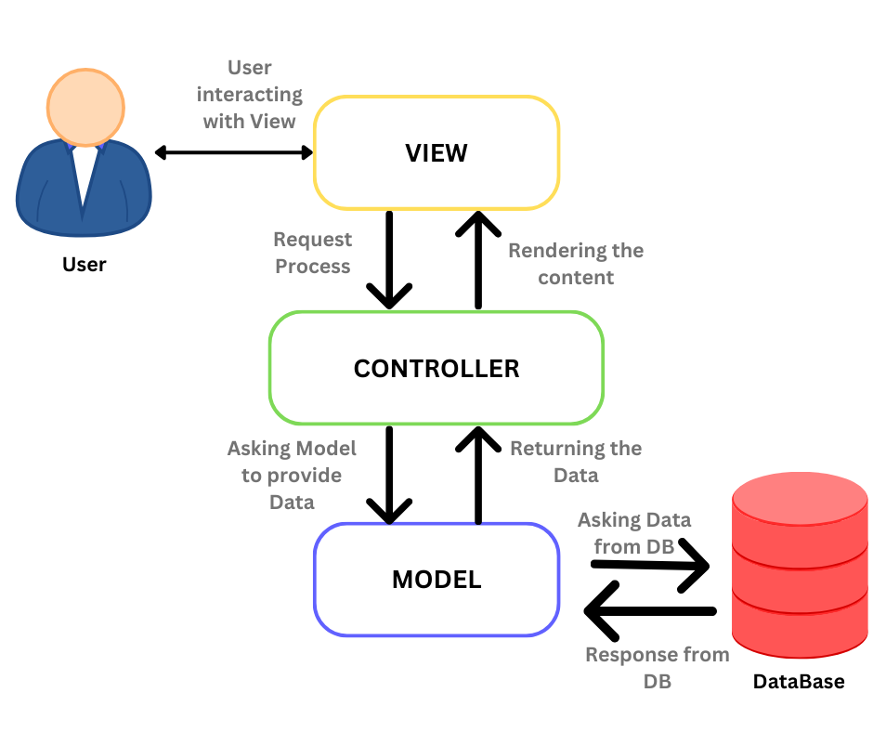
Why we chose MVC?
MVC
1
Separation of Concerns
2
Modularity and Maintainability
3
Reusability
4
Parallel Development
5
Testability

Slide 36


Model
1
Key Components for Model:
Diagram Data Structures
Templates and Assets
User Data
Storage Management
Represents the application's data and business logic. For the ODT, this includes data structures for diagrams, shapes, templates, and user profiles.
Model components are :
User Model
Project Model
Diagram Model
Diagram element model
Comment Model
Permission Model
2

Slide 37
View
1
Key Components for View:
User Interface
Responsive Design
Manages the presentation layer. For the ODT, this involves rendering the user interface, including the diagram canvas, toolbars, and menus.
Interaction Between Model and View:
Updating the view
User Actions
2

Slide 38
Controller
1
Key Components for Controller:
Input Handling
Data Synchronization:
Input Handling
Handles the input logic and updates the Model and View accordingly. For the ODT, this includes user interactions like creating shapes, editing diagrams, saving files, and so on.
User Interaction (Controller):
The user clicks on the canvas to create a new shape.
The Controller captures the click event and determines the appropriate action.
2

Slide 39



Summary
The MVC architectural style is well-suited for the ODT because it provides a clear separation of concerns, facilitating modularity, maintainability, and parallel development. It ensures that the application is organized, making it easier to develop, test, and extend. By leveraging MVC, the ODT can provide a robust, user-friendly, and maintainable platform for creating and managing software analysis and design diagrams.

Slide 40
Design Patterns
What’s more appropriate for ODT?

Slide 41
Design Patterns
Purpose
Ensure robust, maintainable, and scalable architecture
Provide proven solutions to common software design problems
Facilitate better communication among developers
Enhance code reusability and flexibility
Overview
Covers essential design patterns implemented in ODT
Categorized into structural, behavioral, and creational patterns

Slide 42
Structural Design Pattern: Facade
Purpose:
Simplifies the interface to a complex subsystem
Reduces dependencies between the client and the
subsystem
Benefits:
Simplifies client interaction
Reduces dependency between clients and subsystems
Enhances maintainability and flexibility
Behavioral Design Pattern: Observer
Purpose:
Notifies objects of changes in another object
Useful for distributed event handling systems
Benefits:
Decouples subject and observers
Promotes loose coupling
Facilitates event-driven architecture

Slide 43
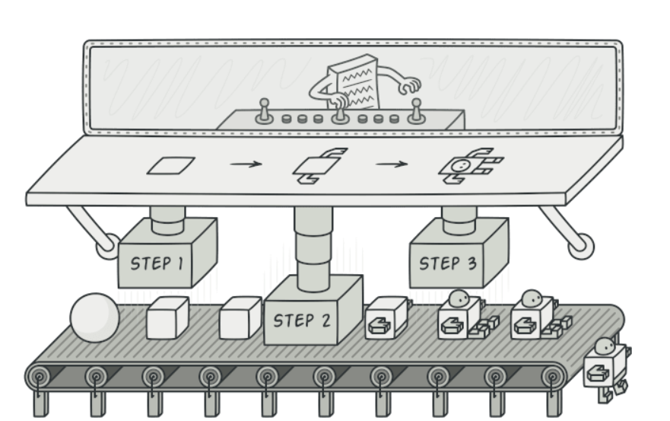
Creational Design Pattern: Builder
Purpose:
Separates construction of a complex object from its representation
Allows for different representations of the same construction process
Benefits:
Clear separation between construction and representation
Allows step-by-step construction
Enhances readability and maintainability

Slide 44
Design Patterns
Summary
Facade: Simplifies complex subsystems
Observer: Supports event-driven architecture
Builder: Facilitates construction of complex objects
Overall Impact
Provides structured solutions
Enhances system robustness, maintainability, and scalability

Slide 45
Future Enhancements
Biometric Authentication
Improved UI
Enhanced Encryption
Techniques
API Integration
1
Cross-Platform
Compatibility
Enhanced Integration
Capabilities

Slide 46

Potential Questions
What mechanisms are in place for data recovery in the event of a failure?
How does the ODT handle user collaboration on projects?
How does the ODT ensure data security and privacy?

Slide 47
Conclusion
In a nut shell, the Online Design Tool (ODT) is a comprehensive platform designed for efficient project and diagram management, robust security measures, and seamless collaboration functionalities. It focuses on user-friendly interfaces, advanced security, and enhanced integration capabilities. Future enhancements, including machine learning integration, real-time collaboration, and advanced search capabilities, will further elevate its utility. ODT meets the evolving needs of designers and engineers, providing a powerful and reliable tool for the modern design landscape.

Slide 48
Reference Citations
https://www.tutorialspoint.com/software_architecture_design/introduction.htm
https://www.youtube.com/watch?v=NU_1StN5Tkk
https://www.geeksforgeeks.org/software-design-patterns/
https://www.visual-paradigm.com/
https://www.javatpoint.com/data-structure-tutorial
https://www.tutorialspoint.com/mvc_framework/mvc_framework_introduction.htm

Slide 49
Any Questions?

Slide 50
THANK YOU
Sincerely for your kind attention

